Slide 1

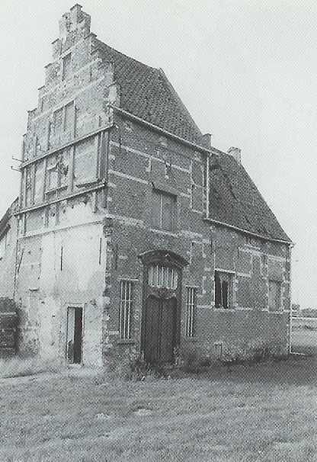




30min
MODERN
JS
Code-Show
FrontendTrack

Slide 2



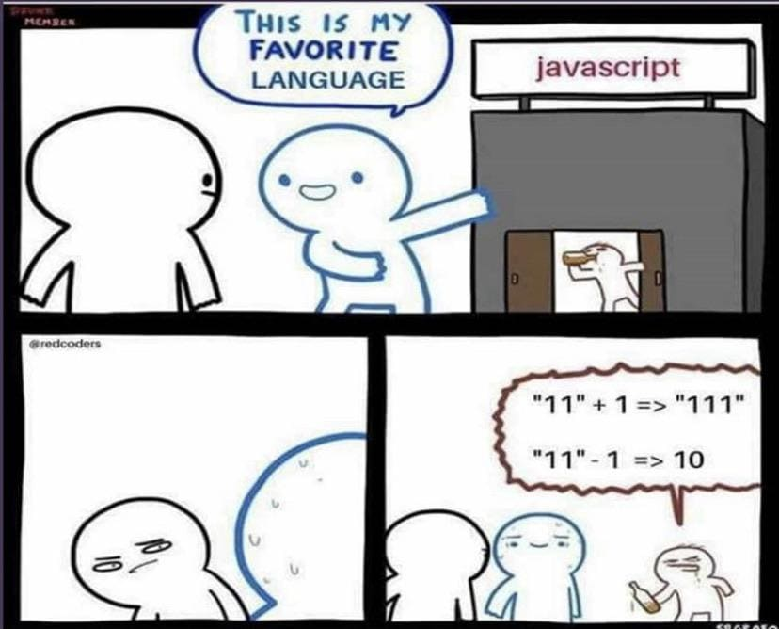

JavaScript?
Everyones favourite language

Slide 3

Debugging JavaScript?

Slide 4


ModernJS?
1991 – First website
1993 – HTML
1996 – CSS
1997 – ES1
1998 – ES2
1999 – ES3
Notes:
JavaScript
Guy L. Steele Jr.
Aka Mocha aka LiveScript
Renamed to JavaScript to piggy back on the success of Java
JavaScript: confusing recruiters since 1997

Slide 5

ModernJS?
The Long JavaScript Winter

Slide 6
ModernJS?
2003 – ES4 abandoned
2006 – jQuery
2007 – iPhone
2008 – HTML5, Android, JS: The Good Parts
2009 – Node & CoffeeScript
2009 – ES5 (JSON, Array.prototype)
Notes:
ES4 abandoned:
Political differences
2009 ES5:
“use strict”, JSON.parse/stringify, Array & Object.prototype stuff

Slide 7
ModernJS?
2010 – AngularJS & Jasmine
2011 – Bootstrap
2012 – TypeScript
2013 – React
2014 – Vue
2015 – Angular

Slide 8

ModernJS?
JavaScript Winter: 1999 – 2015 💀

Slide 9


ES2015
let / const
Arrow functions
Classes
Template Strings
Promises
Rest & Spread
… & many more!
Notes:
More:
Dynamic obj key values: {['field' + index]: true}
Generators: function* fn() { yield true } const gen = fn(); gen.next().value (ended / reset())
for(let num of seq) {}
Functions: Default arguments
Destructuring: for(let [key, value] of Object.entries(obj)) {}
Modules: import/export
Map, Set, WeakSet, WeakMap

Slide 10
ES2016-2018
ES2016
Array.prototype.includes()
Exponentiation operator (**)
ES2017
async/await
Object.entries
ES2018
Object rest/spread
RegExp (named captures, lookbehind, dotall flag)
Asynchronous Iteration
Notes:
RegExp Lookaround:
(?=) - positive lookahead
(?!) - negative lookahead
(?<=) - positive lookbehind
(?<!) - negative lookbehind
dotall flag: s
Asynchronous Iteration:
const promises = [Promise.resolve(1), Promise.resolve(2)]
for await (const line of promises) {
expect(typeof line).toBe('number')
}

Slide 11



Menu
ECMAScript 2019-2024
TypeScript

Slide 12



Let’s Start!

